Slide 1
Super Store Sales Analysis
Disclaimer: The information provided in this text is not factual and is for illustrative purposes only

Slide 2
Report Objective
Period: 2015 – 2018
Introduction | This report analyzes sales performance across different regions, product categories, and periods to understand market trends, identify strengths and weaknesses, and support strategic decision-making.
Conclusion | The report includes key performance indicators (KPIs), customer behavior analysis, order distribution, and outlier detection — all of which significantly contributed to accurate data understanding and generating actionable insights.
Findings and Observations | One of the key findings was the reduction of skewness in sales distribution. Initially, the mean sales value was nearly five times greater than the median, indicating a strong right skew. After addressing outliers, the gap between the mean and median narrowed significantly, resulting in a more realistic and reliable interpretation of sales performance.
Team 1
Sales PROJECT

Slide 3
Super Store Sales Dashboard: (KPIs)
Mean & Median
No of customers & Products
Average Order to ship time
Total Orders & Sales

Slide 4
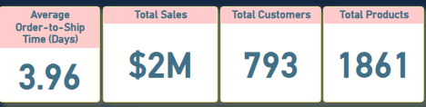
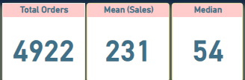
Super Store Sales Dashboard: (KPIs)

Slide 5
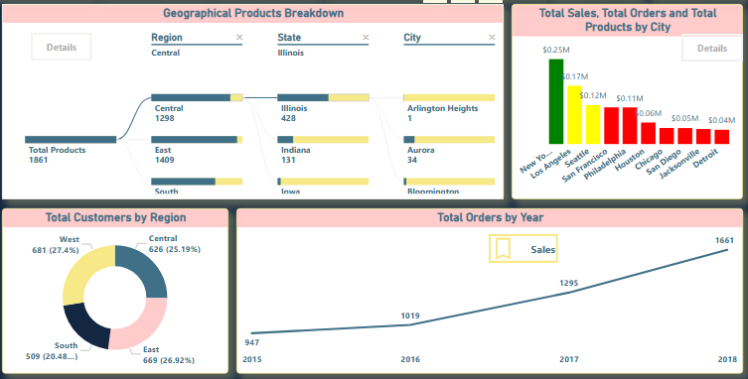
Data Relations in Sales Report

Slide 6
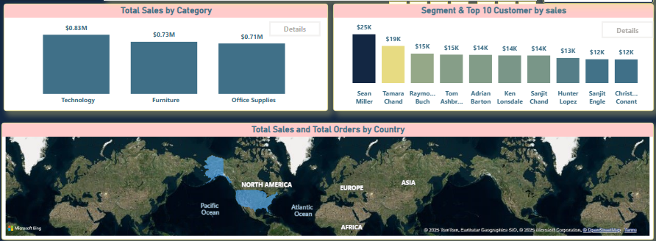
Data Relations in Sales Report

Slide 7
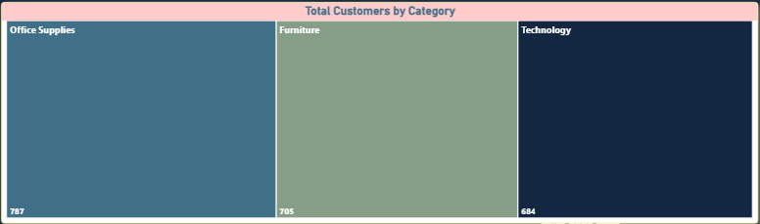
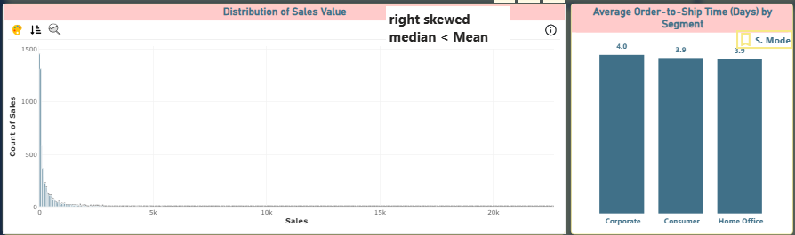
Data Relations in Sales Report

Slide 8
Key Filters (Slicers) Applied in Report
Section
Category
State
(treatment for the effect of outliers)
Region
Product Name
Order Date
Is Outlier
Ship Mode
Customer Name

Slide 9
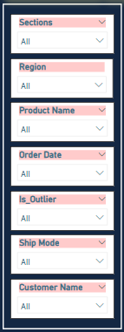
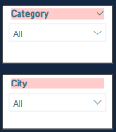
Key Filters (Slicers) Applied in Report

Slide 10
Sales Data Segmentation & Outlier Analysis
مشكلة البيانات و التأثير
وهذا يؤدي الى وجود Outliers
يوجد تباين كبير في الاسعار فى عمود المبيعات
Median حيث يبلغ ال
Mean ربع قيمة ال
حيث تتراوح:
أعلى قيمة
و
اقل قيمة
1/4
22,638
0.44

Slide 11
Sales Data Segmentation & Outlier Analysis
Outliers معالجة الـ
تم تقسيم البيانات إلى قطاعات بناءً على:
)IQR( النطاق الرباعي
)STD( الانحراف المعياري
تم تحديد 1000 أوردر بقيمة 1.45 Outliersمليون دولار فى
موجودة فى الOutliers القيم الشاذة الـقطاعات 5, 6, 7, 8
(فوائد التقسيم إلى قطاعات)
بعد التقسيم تقاربت قيم ال Medianوال Mean
تحسين فهم البيانات وبالتالى قرارات أكثر دقة

Slide 12
Sales Data Segmentation & Outlier Analysis
تحليل القطاعات الرئيسية
ملاحظة: الأوردر الواحد قد يحتوي على منتجات من قطاعات مختلفة.

Slide 13
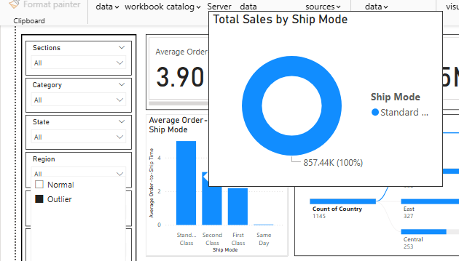
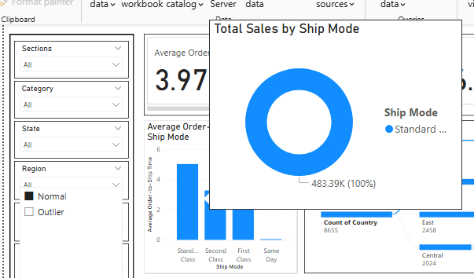
Impact of Outliers on Sales Analysis
):Total Sales by Ship Modeفى تحليل (
.)Outliers (بدون normal ضعف قيمتها فى حالة ال = Outliers مع ال (Standard Ship Mode)قيمة ال
Screenshots كما هو موضح فى ال

Slide 14
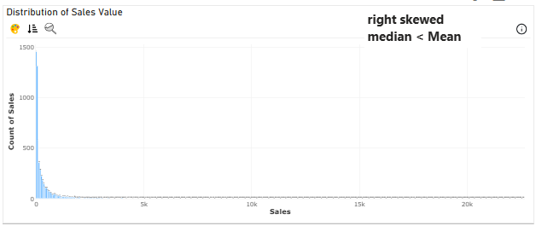
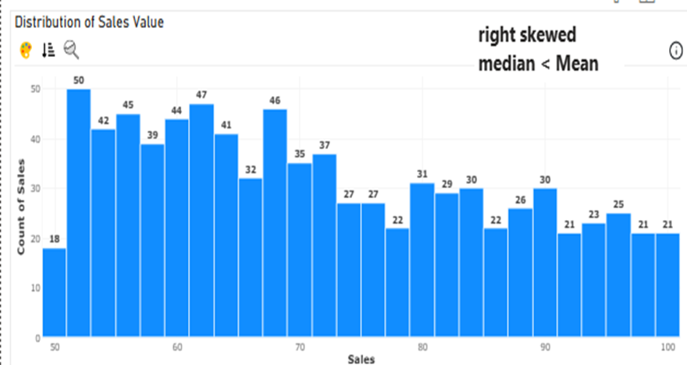
Impact of Outliers on Sales Analysis
:(Right Skewed) على توزيع ال Outliersتأثير الـ
(Right Skewed) يظهر توزيعًا مائلًا لليمين (Histogram)الرسم البيانى
Median < Mean
With outliers
Sectionsبعد التقسيم الى

Slide 15
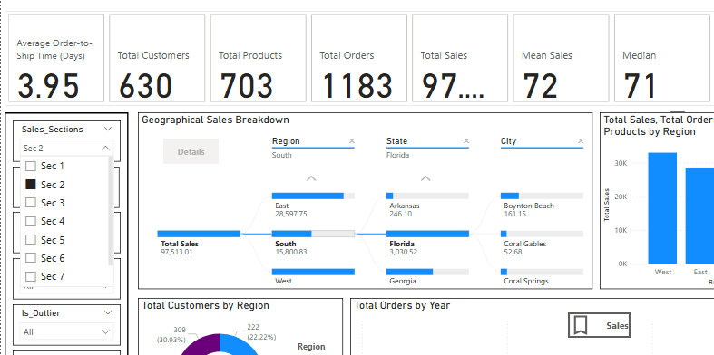
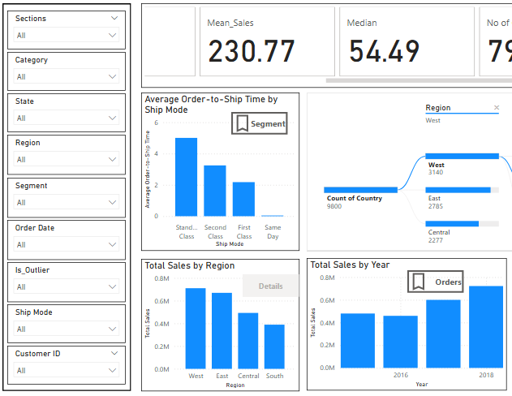
Outliers Effect on Median & Mean

Slide 16
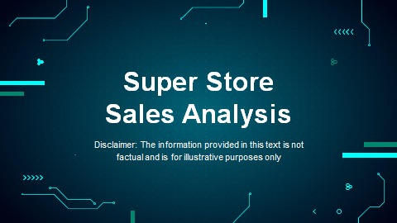


Any Question???

Slide 17






TEAM 1
Janet Essam
Fatma Samy
Hader Karam
Rokia Ashraf
Muhammad Hassan
Nadia Amr

Slide 18

Thank you!
Github Link:
https://github.com/Group1PBI/Store-Sales-Dataset-Analysis-Project/blob/main/Super_Store_Sales_Project.pbix
Disclaimer: The information provided in this text is not factual and is for illustrative purposes only

